Slide 1

Customer Churn Prediction for Vodafone Idea
JUBI RANKA

Slide 2
Executive Summary
Market Dynamics :
Indian telecom market is highly competitive and price sensitive
Strategic pricing is crucial for customer retention and acquisition
Recent Customer Trends:
JIO raised prices, leading to significant customer churn.
Vodafone Idea raised tariffs by 10-20%
BSNL gained 2.9 million new customers by targeting the right audience and maintaining affordable plans
Logistic Regression Model:
Developed a model to predict customer churn.
Analyzes customer behavior to optimize retention and expand the customer base.
Benefits of the Model:
Reduces risks of customer loss.
Enhances operational efficiency and decision-making processes.
Empowers companies to navigate market complexities and drive sustainable growth.

Slide 3
Problem
Vodafone Idea has been experiencing customer churn for an extended period. They aim to develop a model that predicts customer churn based on customer details. This model will enable them to analyze which customers are at risk of churning, allowing for data-driven decisions to retain those customers effectively.

Slide 4
Solution
After a thorough Exploratory Data Analysis (EDA) and data transformation, we tested various machine learning models:
Algorithms Used:
Decision Tree
Random Forest
Support Vector Machine (SVM)
Logistic Regression
K-Nearest Neighbors (KNN)
Each model's performance was evaluated based on accuracy and overfitting tendencies.
This approach ensured the final model was robust, accurate, and effective for customer churn prediction.

Slide 5
Model in Use
We have used Logistic Regression to predict customer churn because of the under given reasons:
Efficient for binary classification
Handles imbalanced datasets effectively.
Provides clear probability estimates for churn likelihood.
Balances precision and recall, reducing false positives/negatives.
Computationally efficient with quick training and predictions

Slide 6
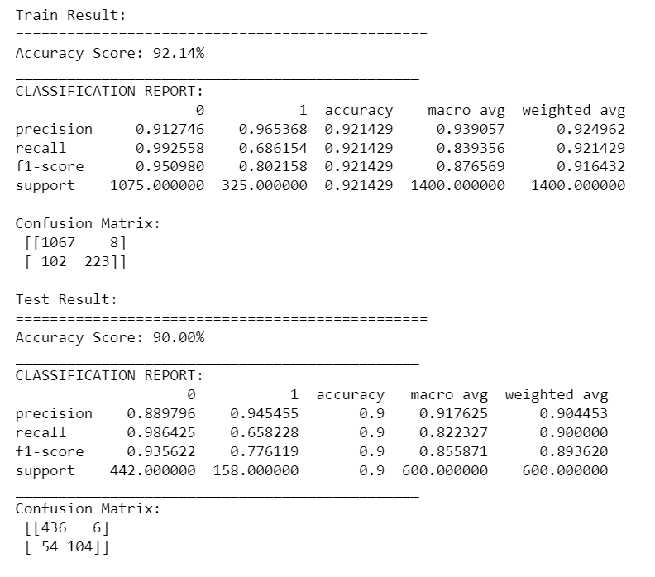
Model Accuracy
Model Accuracy and Generalization:
Training Accuracy: 92.14%
Test Accuracy: 90.00%
Churn Class Performance (Class 1):
Precision: 94.54% (high accuracy in predicting churn).
Recall: 65.82% (34% of churned customers missed; need for improvement).
F1-Score: 77.61% (balance between precision and recall, but prioritize recall enhancement).
Non-Churned Class Performance (Class 0):
Recall: 98.64% (excellent identification of non-churned customers).
Precision: 88.98% (acceptable, reducing unnecessary retention efforts).
Class Imbalance Impact:
Model performs better on non-churners, indicating a need to improve churn identification (recall for Class 1).
High precision achieved, but enhancing recall is essential to capture more at-risk customers.

Slide 7

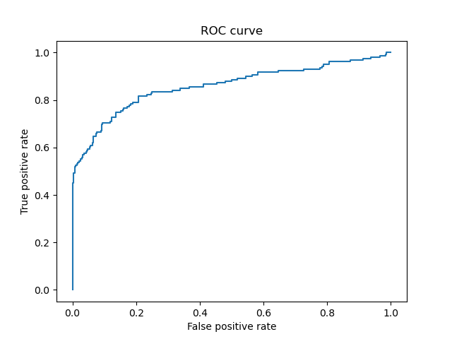
AUC ROC Curve
Strong Model Performance:
The ROC curve is bowed toward the top-left, indicating strong predictive power for distinguishing between churners and non-churners.
Low False Positive Rate:
The model effectively minimizes false positives, meaning fewer non-churners are misclassified as churners.
High True Positive Rate:
The curve reflects a high recall, capturing a significant portion of actual churners.
Better Than Random Guessing:
The curve lies well above the random classifier line (y = x), confirming the model performs significantly better than random.

Slide 8
Thank you

